Slide 1
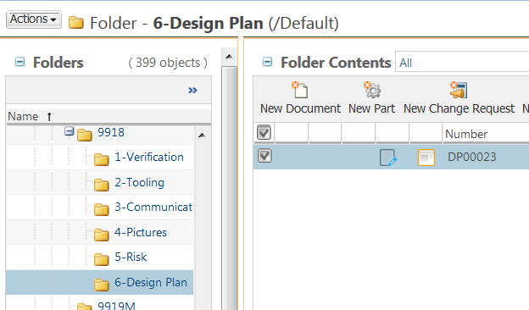

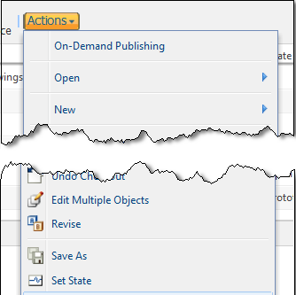

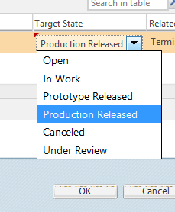

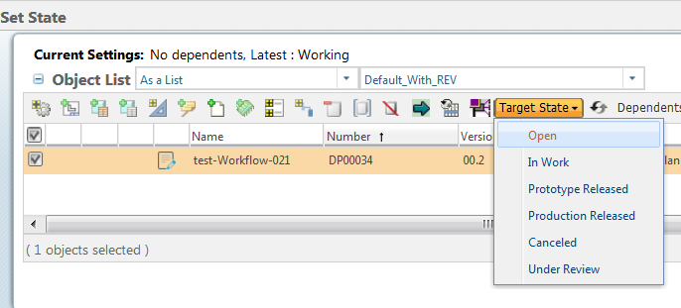
How to Set State of objects in Windchill
a. From any Windchill tables. Select objects that need to change state by checking the check box.
1 Select
a
NOTE: - you can select many documents.
b. Click Actions.
c. Select Delete.
b
2 Action
NOTE: Setting state of an object is limited by access rights, depending on document type and its state.
c
CAUTION: Choosing “Delete all revision…” will totally remove the object from Windchill.
In the save dialog box:
d. Choose “Target State”
e. Click OK
d
NOTE: You cannot delete files that have a Released status.
e
Tool Tips
If you have many objects to change state. Select the checkboxes to select all objects then set the target using the menu.
3 Delete

